Slide 1

IAG Take Home Exercise
Analytics Engineer
Carol Moynham
July 2025

Slide 2


Slide 3


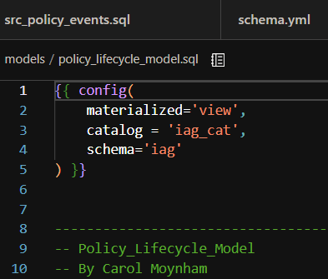

Four steps to address the ask of transforming raw data into a clean, queryable, meaningful source for downstream users
Set Up
Think
Model
Query and Share
Profile.yml
DB Token
Create accounts for DBT and DataBricks
Create workspace and schema
Load Policy data into Databricks
Connect between DBT and Data Bricks
Re-read the exercise
Explore the data
Conceptualise model
Assumptions
Start by creating a source table with the raw data
Build the quote bind model to address need for specific journeys in this space
Summary
Queries in DataBricks
Self-serve dashboard
Document and Test across every stage

Slide 4
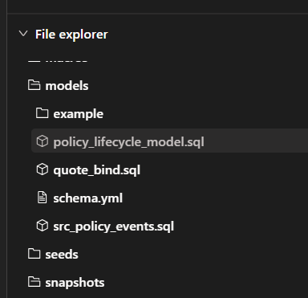
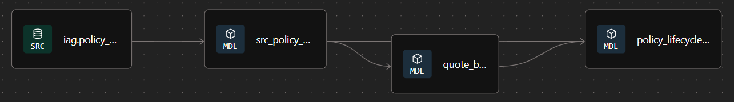
Three models built in DBT: src_policy_events, quote_bind and policy_lifecycle_model, documentation in schema.yml
SRC_Policy_Events
Raw data
Could be cleaned or updated at this level if needed
Quote_Bind
To address the need for average time from quote to bind
Splits each quote-bind cycle into it’s own event, by policy
Policy_Lifecycle_Model
Summary combining data from source table and quote_bind
Schema.yml
Documents metadata for models
Can also be used to document for seeds, sources and test
Option to automate .yml creation using AI tools like DBT Copilot (Cloud only)

Slide 5


